Slide 1
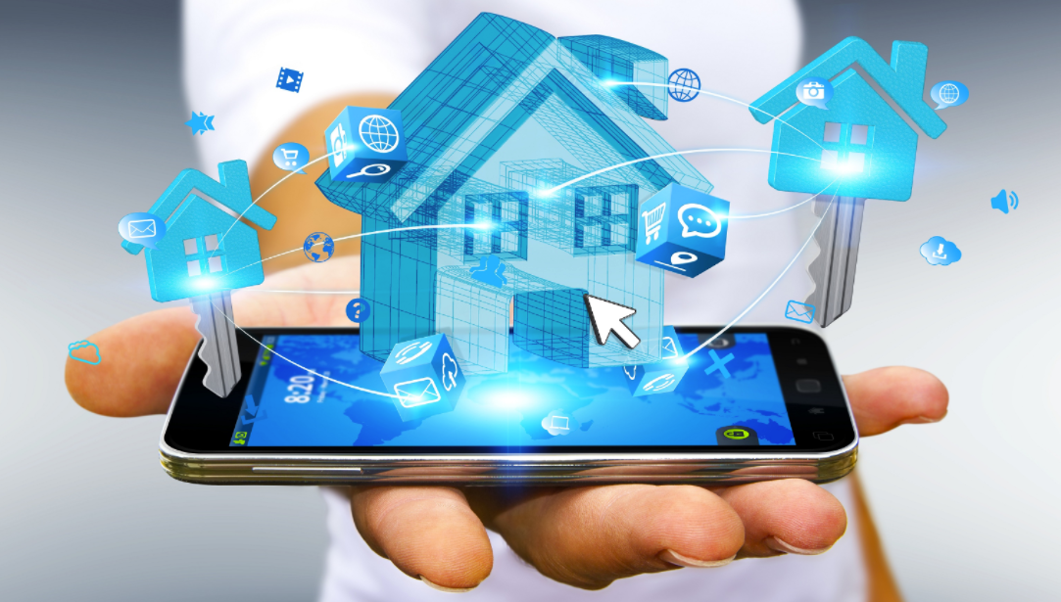
SMART HOME
OCTOBER
2018

Slide 2
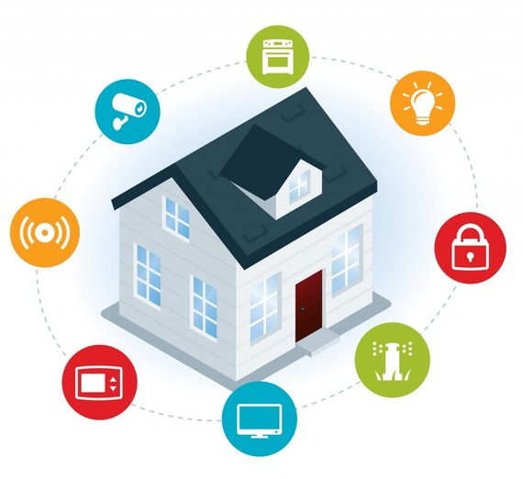
OVERVIEW
A smart home is a residence that uses internet-connected devices to enable the remote monitoring and management of appliances and systems, such as lighting and heating.

Slide 3
THE PROBLEM
Energy is mostly wasted at homes, offices and laboratories.
As humans, we may not be able to manage energy efficiently due to forgetfulness.
Moreover, we wish we could switch on/off our lighting systems, appliances and other devices away from home.

Slide 4
THE SOLUTION
Smart Home will allow users to control their lighting system, appliances and other devices.
Certain environmental readings such as temperature and humidity can be observed from the web app or phone app which may be useful in laboratories.
We seek to implement this solution as shown in the next slide

Slide 5
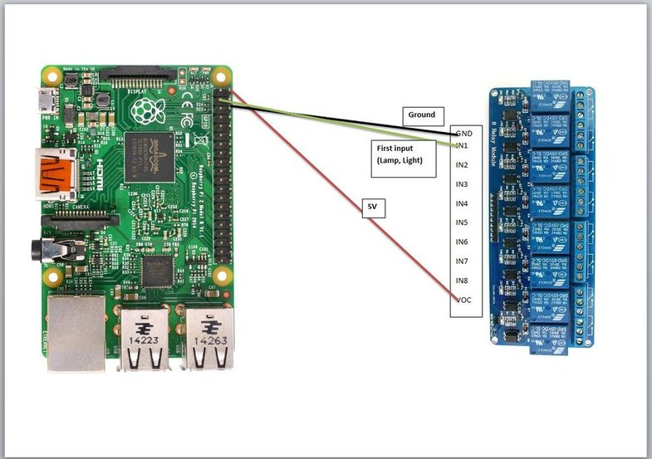
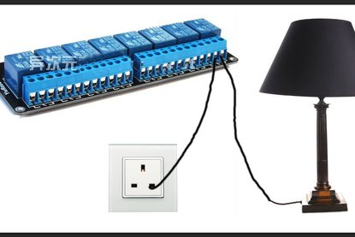
THE SOLUTION

Slide 6
Hardware resources
Raspberry Pi 3
Infrared sensor
Relay Connector
Temperature & Humidity Sensor (DHT11)
Switch
Bulb
Copper wire

Slide 7
Other (Technologies) Resources
Mqqt Protocol (Mosquito Broker)
Heroku
Python3
Django
React
React Native

Slide 8
THANK YOU!
Dawud Ibrahim Ismail
Nsiah Akuoko Jeremiah

